Slide 1

University Catalog Management System v2.0
Presenter : Christopher Sutton
Mentor: Tim Downey
Team Member: Jose Astudillo
Professor: Masoud Sadjadi

Slide 2

What is UCMS?
The University Catalog Management System…
Provides a way to manage catalogs at FIU past and present.
Looks to replace the hard copy catalogs.
Facilitates the work of advisors and administrators.

Slide 3
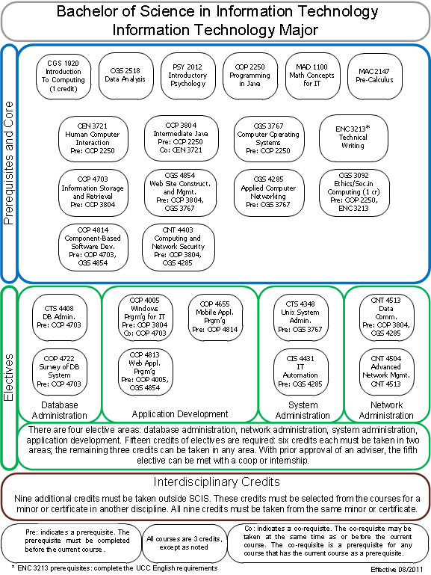
Problems to Solve in v2.0
No way to visualize a degree track, group, or set in the current system.
Currently flowcharts are made using Microsoft Visio.
Does not represent the most recent data.
Difficult to alter.
Not dynamic.

Slide 4
Solution
Implement a dynamic way to create flowcharts!
Use current and past catalog data to build a default representation of a degree program.
Implement algorithm to take into consideration course pre-requisites.
Allow advisers and administrators to dynamically alter a program structure.
Implement an algorithm to write positional values to the database for groups, sets, and courses.

Slide 5
Requirements
Leverage valid information in the database.
Dynamically create track, group, and set flowcharts.
Design and layout is not static and can be easily modified by using CSS.
Allow elements to be dragged to new locations while maintaining important metadata.
Advisers and administrators should be able to alter a structure of a track, group, or set and save their changes so they are viewable when the page is refreshed.

Slide 6
Implementation
Requirements were implemented using the following…
Yii Framework
PHP
JavaScript
HTML
CSS

Slide 7
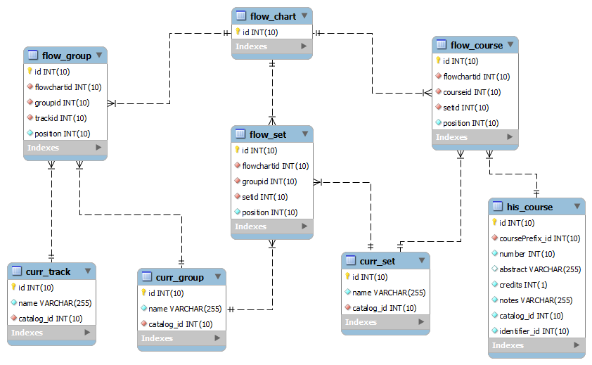
Flowchart Database Model

Slide 8
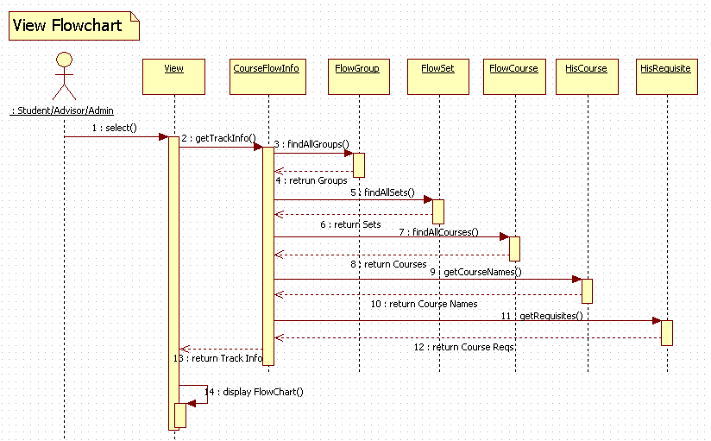
View Track Sequence Diagram

Slide 9
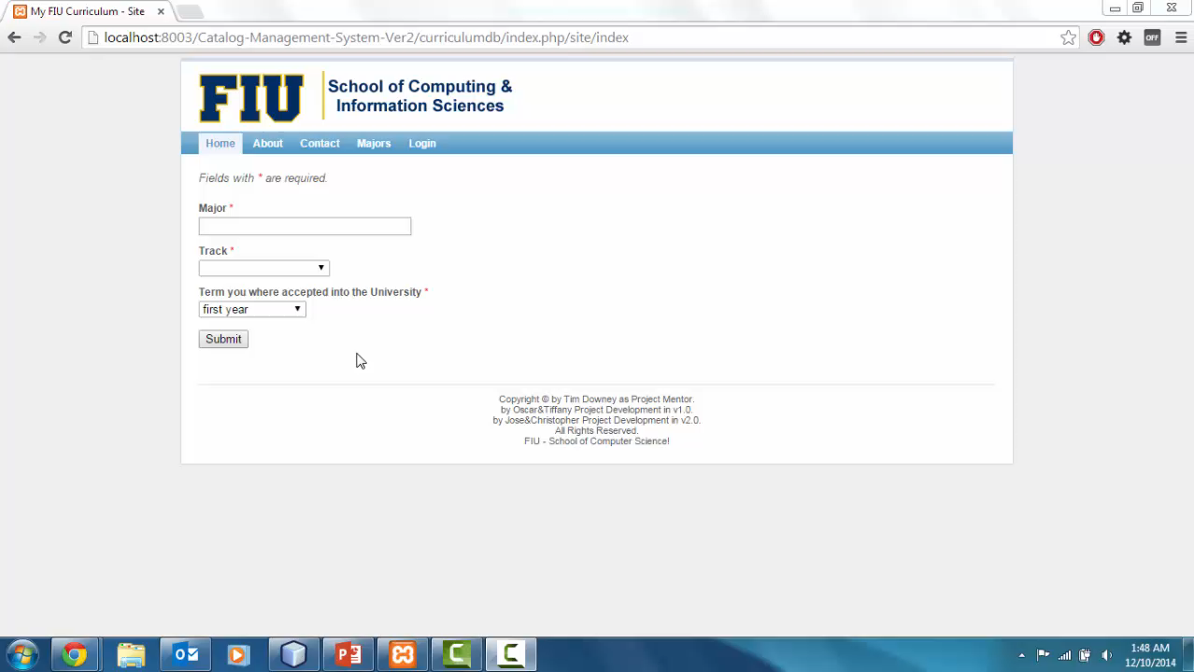
Demo

Slide 10
Future Modifications
More appealing CSS design to better mimic original flowchart.
Use the same flowchart foundation to allow advisers to propose new degree structures by dragging courses.

